Slide 1
Sprint 3
Level shifts

Slide 2
Agenda
Level shifts
strucchange package
tsoutliers package
rank-based shift detection
Timestamps
Data aggregation
gwloggeR v0.1.2

Slide 3
Level Shifts

Slide 4
strucchange package
For modeling changes in mean

Slide 5
Level shift?

Slide 6
Strucchange package

Slide 7
Strucchange package
Pros:
Detects changes in a linear model (e.g. intercept only linear regression)
Mature package
Speed: 5 min average
Cons:
No ARIMA support
Uses lots of memory (+5GB on some cases)

Slide 8
tsoutliers package
Level Shifts

Slide 9
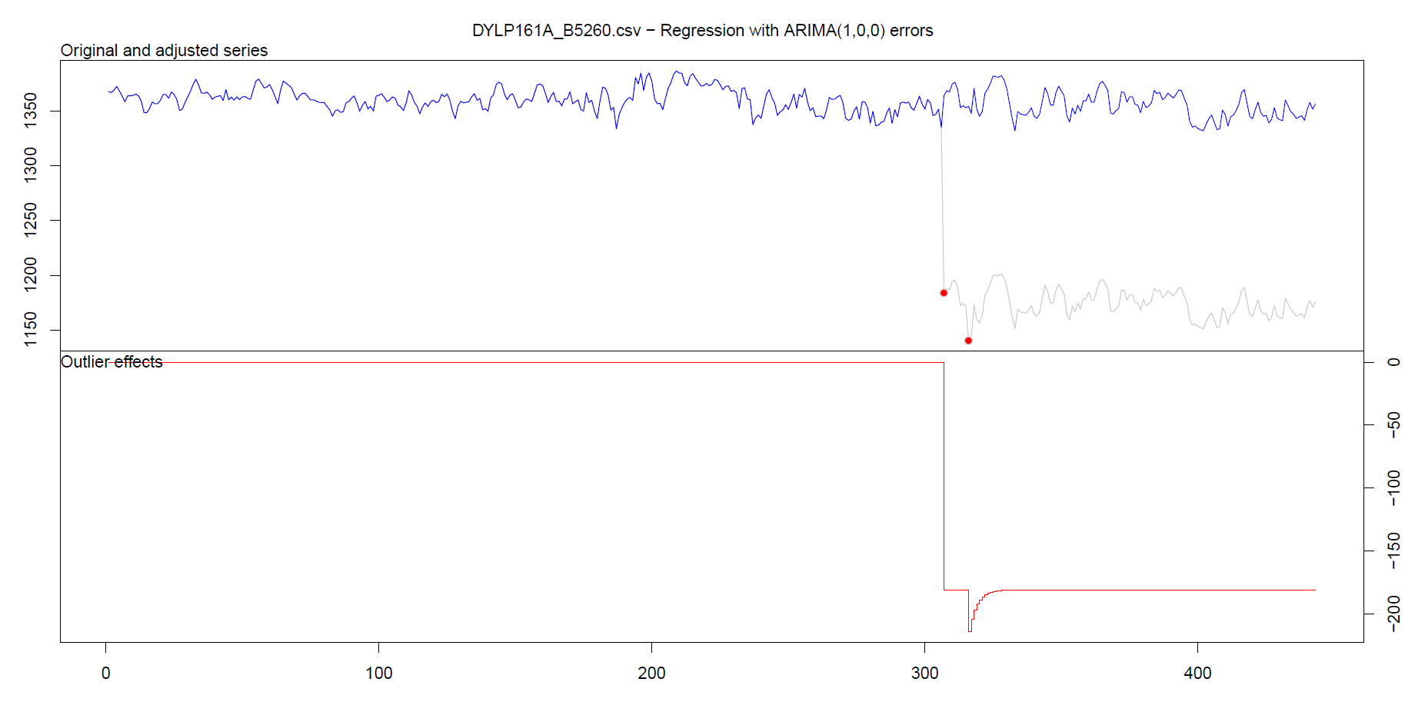
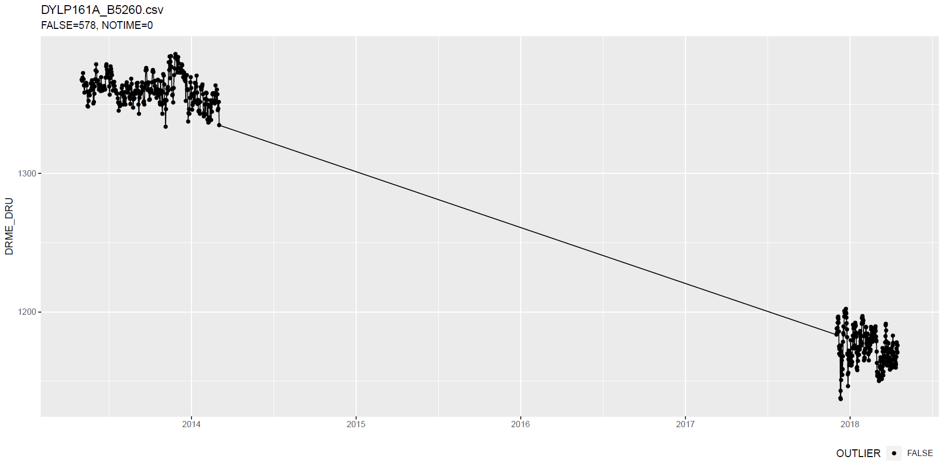
tsoutliers package

Slide 10
tsoutliers package
More cases: see here.

Slide 11
tsoutliers package
Pros:
Allows for a wide range of ARIMA-based models
Speed: 10 min average with aggregation
Cons:
Can not be used without aggregation (for >5k points)
Package is still in development

Slide 12
Rank-based shift detection

Slide 13
Rank based level shift detection
Fried, R. e.a., On rank tests for shift detection in time series, 2007
Bovik, A.C. e.a., Nonparametric Tests for Edge Detection in Noise, 1986
Based on the distribution of a test statistic (e.g. Wilcoxon statistic) the normal situation can be defined. Based on this definition, exceptional shift situations could be detected.
Pro: speed!

Slide 14
Defining Level Shift

Slide 15
Level shift?

Slide 16
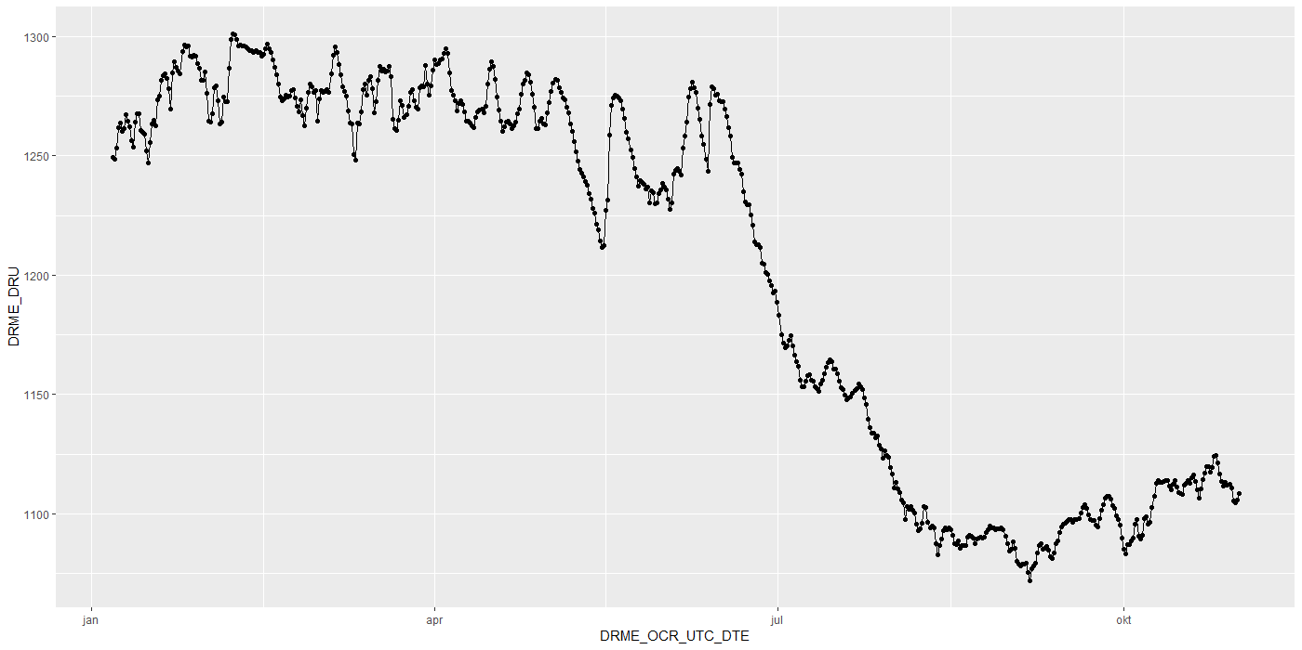
Level shift?

Slide 17
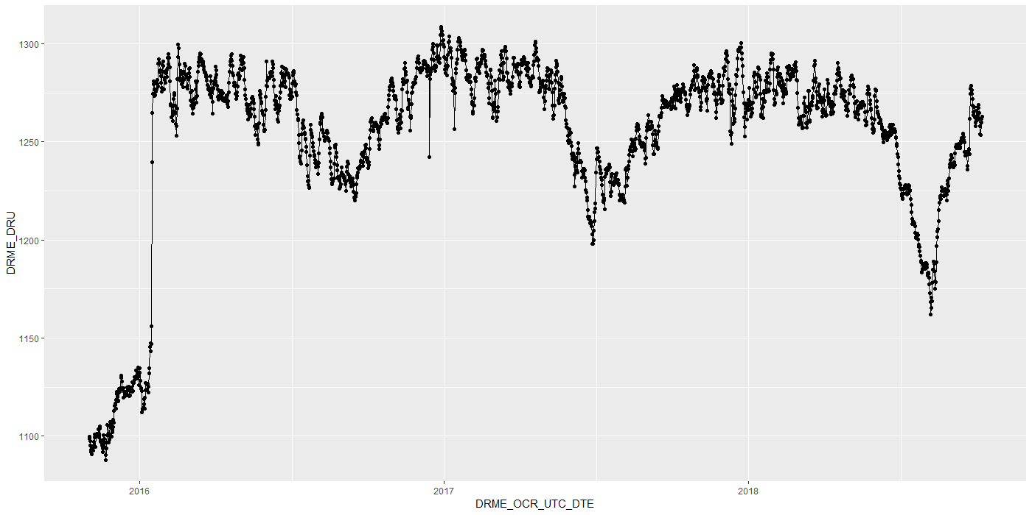
Level shift?

Slide 18
Level shift?

Slide 19
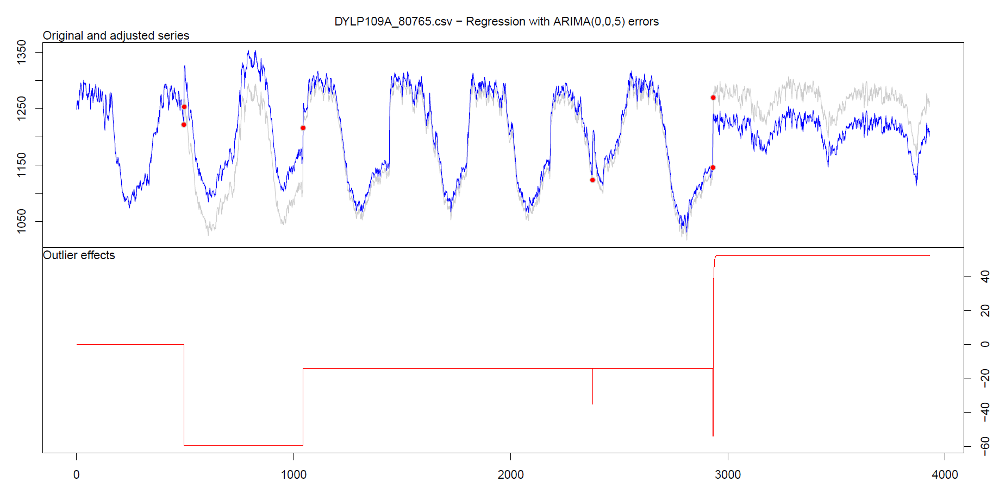
Level shift: tsoutliers

Slide 20
Timestamps

Slide 21
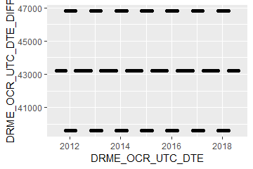
Timestamps: varying time-difference between observations (BAOL068X_180816.csv)
Sometimes 11, 12 or 13 hours
Notes:
BAOL068X_180816.csv

Slide 22
Timestamps: varying time-difference between observations
Equidistant observations are important for ARIMA-like timeseries models.
Without equidistance, the usability of ARIMA is limited.
Example: Differencing
For small time-differences: measured differences determined by sensor inaccuracy
For large time-differences: measured differences determined by sensor inaccuracy and atmospheric changes.
Timestamps: Take into account all kinds of scenarios?

Slide 23
Importance
Visualization:
Its either TIMESTAMP or SEQUENCE
INBO:
Can make sure that timestamp is always available.
Other parties?

Slide 24
gwloggeR
Change log
Feedback?

Slide 25
Change log
“Diver” → “hydrostatic pressure”
ap <- apriori("hydrostatic pressure", "cmH2O")
detect_outliers(x, apriori = ap)
detect_duplicates(ts)

Slide 26
Aggregation function
Based on mean

Slide 27
Next steps

Slide 28
Next steps
Outliers v0.02
Build kernel based on clean data
Simulation test: verify power
Document in detail
Gather more Level Shift examples
Notes:
temporal change : multiple points after the change should be “red”
Level shifts: how to flag those?

Slide 29
Hysteresis?

Slide 30
The End

Slide 31
Sprint 2
Outliers

Slide 32
Agenda
DRME_DMST_CDE validation
Outliers: v0.02 update
Comparison v0.01 vs v0.02
gwloggeR v0.1.1
Assessment
anomalize
tsoutliers

Slide 33
DRME_DMST_CDE
Flags from DB: ENT (entered); DEL (deleted) and INV (invalid).

Slide 34
DRME_DMST_CDE
On all *.csv-data:
DEL ENT INV VLD <NA>
462 556271 4697 16 0

Slide 35
DRME_DMST_CDE: VLD and DEL
PPNT_ID PPNT_CDE DRSO_ID DRSO_SER_NBR DRME_ID DRME_OCR_UTC_DTE DRME_DRU DRME_TPU DRME_DMTP_CDE DRME_DMST_CDE SEQUENCE
1: 7019 BAOL001X 275 D0939 238389 2010-11-11 10:00:00 1018.100 NA LDME VLD 1093
2: 7019 BAOL001X 275 D0939 1824560 2010-11-11 10:00:00 1018.075 6.033 LDME ENT 1130
3: 7019 BAOL001X 275 D0939 238390 2010-11-11 22:00:00 1007.300 NA LDME VLD 1094
4: 7019 BAOL001X 275 D0939 1824561 2010-11-11 22:00:00 1007.275 8.163 LDME ENT 1131
5: 7019 BAOL001X 275 D0939 238391 2010-11-12 10:00:00 1015.400 NA LDME VLD 1095
6: 7019 BAOL001X 275 D0939 1824562 2010-11-12 10:00:00 1015.375 11.213 LDME ENT 1132
7: 7019 BAOL001X 275 D0939 238392 2010-11-12 22:00:00 1012.900 NA LDME VLD 1096
8: 7019 BAOL001X 275 D0939 1824563 2010-11-12 22:00:00 1012.850 12.457 LDME ENT 1133
9: 7019 BAOL001X 275 D0939 238393 2010-11-13 10:00:00 1014.600 NA LDME VLD 1097
10: 7019 BAOL001X 275 D0939 1824564 2010-11-13 10:00:00 1014.600 10.810 LDME ENT 1134
11: 7019 BAOL001X 275 D0939 238394 2010-11-13 22:00:00 1012.700 NA LDME VLD 1098
12: 7019 BAOL001X 275 D0939 1824565 2010-11-13 22:00:00 1012.675 10.953 LDME ENT 1135
Duplicates: Detect those too?
Notes:
Duplicaten in de DB?

Slide 36
DRME_DMST_CDE: INV
Validation

Slide 37
DRME_DMST_CDE: INV
Validation

Slide 38

DRME_DMST_CDE: INV
Validation
No Timestamp (Inconsistent)
No Timestamp: Detect those too?
Notes:
Inconsistent because there are also black dots that have no timestamp.

Slide 39
Outliers: v0.02 update
Uses simple a-priori knowledge about air pressure, temperature, etc.

Slide 40


Outliers: v0.02 update
Validation
Excluded: BAOL089|BAOL079|BAOL006 (mBar)
Range: 800 < x < 1200
Notes:
Excluded: BAOL089|BAOL079|BAOL006
Range: 800 < x < 1200

Slide 41
Outlier comparison
v0.01, v0.02, DRME_DMST_CDE

Slide 42
Outlier comparison

Slide 43
Outlier comparison

Slide 44
Outlier comparison

Slide 45
Outlier comparison

Slide 46
Outlier comparison

Slide 47
Outlier comparison

Slide 48
Outlier comparison

Slide 49
Outlier comparison

Slide 50
tsoutliers package

Slide 51

tsoutliers package
auto.arima(Nile)
Series: Nile
ARIMA(1,1,1)
Coefficients:
ar1 ma1
0.2544 -0.8741
s.e. 0.1194 0.0605
sigma^2 estimated as 19769: log likelihood=-630.63
AIC=1267.25 AICc=1267.51 BIC=1275.04
nile.outliers <- tso(Nile,types = c("AO","LS","TC"))
nile.outliers
Series: Nile
ARIMA(0,0,0) with non-zero mean
Coefficients:
intercept LS29 AO43
1097.7500 -242.2289 -399.5211
s.e. 22.6783 26.7793 120.8446
sigma^2 estimated as 14401: log likelihood=-620.65
AIC=1249.29 AICc=1249.71 BIC=1259.71
Outliers:
type ind time coefhat tstat
1 LS 29 1899 -242.2 -9.045
2 AO 43 1913 -399.5 -3.306
Notes:
https://stats.stackexchange.com/questions/104882/detecting-outliers-in-time-series-ls-ao-tc-using-tsoutliers-package-in-r-how

Slide 52
tsoutliers package: AO’s

Slide 53
tsoutliers package: AO’s

Slide 54
tsoutliers package: AO’s
WRONG
TIMESTAMPS NOT SEQUENTIAL
Notes:
Afstandedn veel groter sinds 2018

Slide 55

tsoutliers package
Pros:
Formalism
Integration with (S)ARIMA
Cons:
Speed? (+12h on BAOL033X_C6550.csv)
Ad-hoc (messy) solution
ToDo:
Simulations for validation
Visualization of AO, LS en TC outliers
Think it best works with “all” outliers enabled.
Notes:
Zou best

Slide 56
anomalize package

Slide 57

anomalize package
vs. tsoutliers
Notes:
Same Nile dataset

Slide 58
anomalize package
Pros:
Straightforward and fast timeseries decomposition
Cons:
Only AO
LS and TC can not be specified
Not backed by decent theory
Notes:
Zou best

Slide 59
gwloggeR
Feedback?

Slide 60
Next steps

Slide 61
Next steps
Define control vocabulary?
Suggested function output:
?
Notes:
temporal change : multiple points after the change should be “red”
Level shifts: how to flag those?

Slide 62
Next steps
Go further with tsoutliers
Visualisation: level shift (LS)
Simulations
Give a better idea of model performance for specific cases
Examples:
ARIMA(0,0,0) with AO
ARIMA(0,0,0) with LS
etc.
gwloggeR versioning?
Notes:
temporal change : multiple points after the change should be “red”
Level shifts: how to flag those?

Slide 63
The End

Slide 64
Sprint 1
Outliers

Slide 65
Outliers
v0.01: detect_outliers(data)
Uses only the supplied dataset
v0.02: detect_outliers(data, type = c(“air pressure”, “air temperature”), units)
Uses simple a-priori knowledge about air pressure, temperature, etc.
v0.03: …

Slide 66
Outliers: v0.01
Uses only the supplied dataset

Slide 67
Outliers: v0.01
Validation

Slide 68
Outliers: v0.01
Validation

Slide 69
Outliers: v0.01
Validation

Slide 70
Outliers: v0.01
Validation

Slide 71
Outliers: v0.01
Validation

Slide 72
Outliers: v0.01
Validation

Slide 73
Outliers: v0.01
Validation

Slide 74
Outliers: v0.01
Validation
Scale completely wrong?

Slide 75
Outliers: v0.02
Uses simple a-priori knowledge about air pressure, temperature, etc.

Slide 76


Outliers: v0.02
Validation

Slide 77
Outliers: v0.02
Validation

Slide 78
Outliers: v0.02
Validation

Slide 79
Outliers: v0.02
Validation

Slide 80
Summary
Outliers: v0.01
detect_outliers(data)
Usable on any data (not only L - lucht)
Scale can be completely wrong (cf. BAOL018X_42112)
Outliers: v0.02:
detect_outliers(data, type = c(“air pressure”, “air temperature”), units)
Needs a-priori information
Type
Units
Fixed or dynamic thresholds?
Notes:
Tresholds voor outliers kunnen berekend worden op basis van handmatige prior analyse, of

Slide 81
Outliers: v0.03
Go even further with a-priori information?

Slide 82

Outliers: v0.03
Even more a-priori information to explain variation
Notes:
Bijvoorbeeld, somige regio’s hebben lagere of hogere temperature, wat resulteert in hogere of lagere luchtdruk.

Slide 83
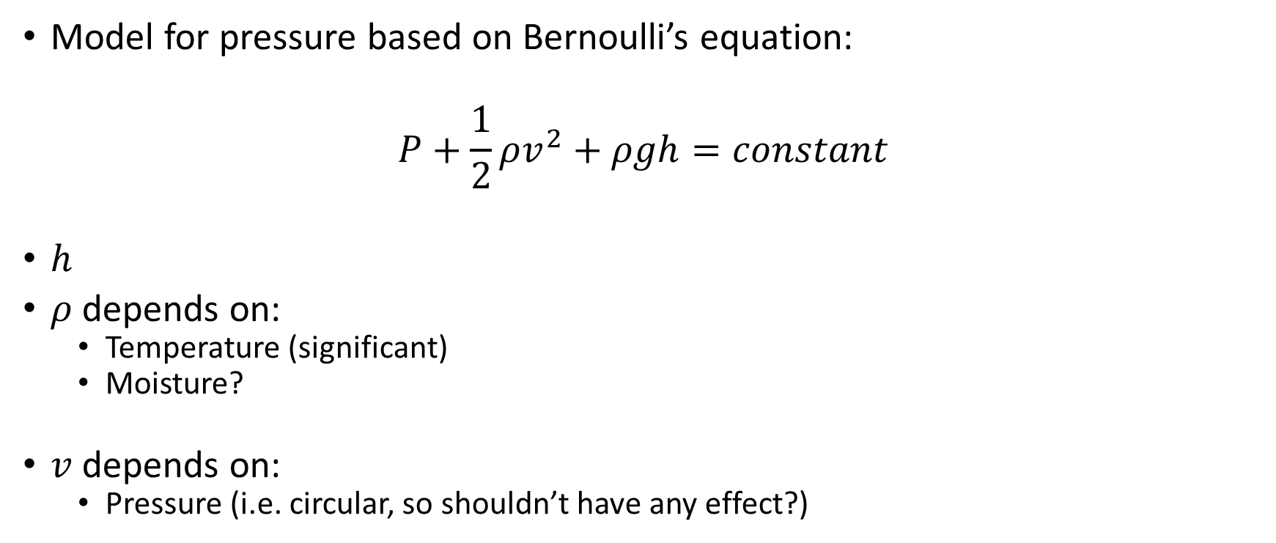
Outliers: v0.03
Model for pressure based on Bernoulli’s equation:
$$P+\frac{1}{2}ρv^{2}+ρgh=constant$$
$h$
$ρ$ depends on:
Temperature (significant)
Moisture?
$v$ depends on:
Pressure (i.e. circular, so shouldn’t have any effect?)

Slide 84

Outliers: v???
First order difference: very long tails
Notes:
Very long tails, not normal

Slide 85
Next steps

Slide 86
Next steps
Make first version of package with outlier detector 0.01 and 0.02?
If no extra data supplied, use v0.01, else v0.02?
v0.02: fixed or dynamic thresholds?
Other ideas?
Notes:
Misschien best om zo snel mogelijk met package te beginnen: dan kan gebruik meteen geevalueerd worden.

Slide 87
The End

